Slide 1
Computer Literacy
Internet, Web, Hardware and Software
Pasewark & Pasewark

Slide 2
Objectives
Define computer literacy
Define the term ‘computer’
Identify the different components of a computer
Define the Internet
Differentiate the Internet and the Web
2
2

Slide 3
Objectives (continued)
Define software
Distinguish between system software and application software
3
3

Slide 4
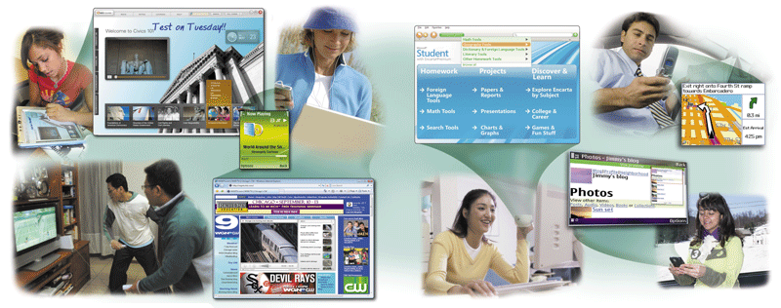
What is Computer Literacy (or Digital Literacy)?
Knowledge and skills required to use a computer as a problem-solving tool
Computers are everywhere
The requirements that determines computer literacy changes as technology changes.
4
4

Slide 5
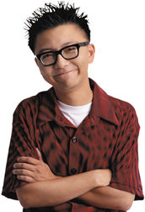
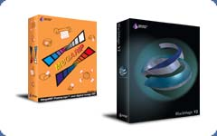
Basic Components of a Computer
People: Computer Programmers, Users or End User.
Software: Instructions that tell the hardware what to do.
Hardware: Equipment associated with the system
5
5

Slide 6
What is a Computer?
How is a computer defined?
A Machine that can be programmed to accept data, process it into useful information, and store it away.
Accepts data
Collection of unprocessed items
Processes data into information
Conveys meaning and is useful to people
Produces and stores results

Slide 7
Basic Activity of a Computer
Input
Process
Storage
Output

Slide 8
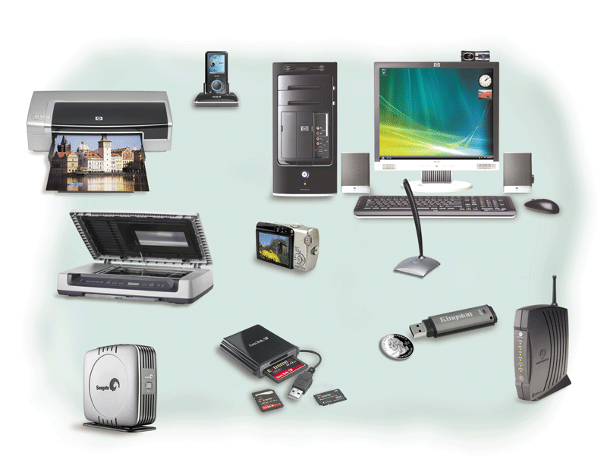
Hardware - Input Device
Hardware used
to enter data
and instructions
8
8

Slide 9
Hardware - Output Device
Hardware that
conveys information to one or more people
9
9

Slide 10
Hardware - Storage Media and Device
Storage is hardware that holds data, instructions, and information for future use
Storage media
Physical material on which data, instructions, and information are stored
Storage device
Records and retrieves items to and from storage media
10
10

Slide 11
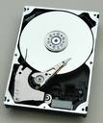
Hardware - Storage Media and Device (Continued)
Storage Media
Storage Devices
USB flash drive
CDs and DVDs
Hard disks
External Hard disk
USB flash drive and external hard disk drives
G:, H:, I: , J:, & K:
Optical disc drive
F:
Hard disk drive
C:, D:, & E
11
11

Slide 12
Hardware – Storage Unit
Storage Unit | Exact Equivalent | Approximate Equivalent
8 bits | 1 byte
1 KB (Kilobyte) | 1,024 bytes | 1,000 bytes
1 MB (Megabyte) | 1,024 KB | 1 Million bytes
1 GB (Gigabyte) | 1,024 MB | 1 Billion bytes
1 TB (Terabyte) | 1,024 GB | 1 Trillion bytes
12
12

Slide 13
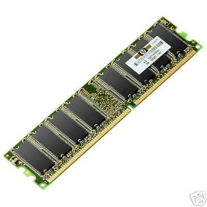
Hardware – Two types of Storage
Secondary Storage
Primary Storage
RAM (Random Access Memory)
When a program runs it primarily stayed in the memory.
It is volatile meaning it is electricity-dependent so all data in it will be lost when power is off.
USB flash drive
CDs and DVDs
Hard disks
External Hard disk
13
13

Slide 14
Software
Software consists of a series of instructions that tells the computer what to do and how to do it
It is the non-tangible (cannot be touch but could
be seen) of a computer.
It is also otherwise known as program.
14
14

Slide 15
Software - Categories
Two Categories of Software
Application software – programs designed to make user more productive. Examples of such are word processing, spreadsheet, database, presentation graphics, accounting, photo editing etc.
System Software - programs that control or maintain the operations of computer hardware (e.g. printer, hard disk). A good example is the Operating System like Windows 7, Linux, Mac OS X etc. It allows program like spreadsheet to run and at the same time store data and as well as print it.
15
15

Slide 16
Networks and the Internet
What is a Network?
Collection of computers and devices connected together through a wire or without wire (i.e. wireless)
Used to share
Saves time and money
Resources
Hardware devices
Information
Software programs
Data
16
16

Slide 17
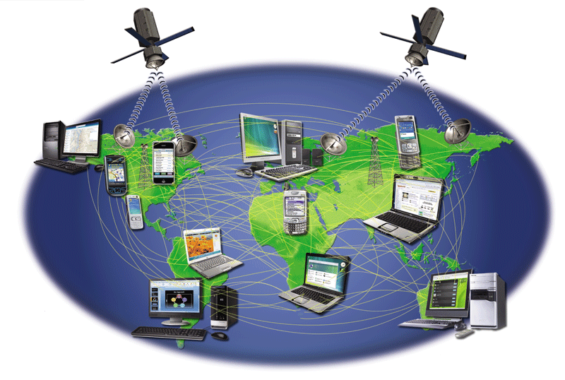
Networks and the Internet
What is the Internet?
Worldwide collection of networks that connects millions of businesses, government agencies, educational institutions, and individuals
17
17

Slide 18
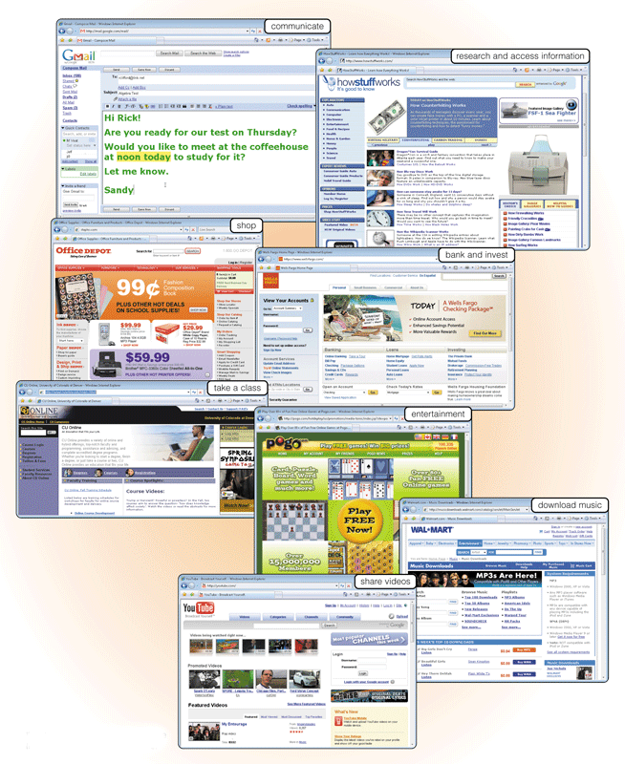
Networks and the Internet
Why do people use the Internet?
Communication
Research and Information
Shopping
Banking and Investing
Classes
Entertainment
Downloading Music/Movies
Sharing Information
18
18

Slide 19
Networks and the Internet
What is Web?
Billions of documents, called Web pages, available to anyone connected to the Internet.
A Web page contains text, graphics, audio, video, and links to other Web pages.
It is not the same as the Internet because the Internet is the network of networks while the Web is one of the application of the Internet.
19
19

Slide 20
Networks and the Internet
What is URL?
Web pages has domain name like www.comfsm.fm or www.facebook.com or www.google.fm
Another name for domain name is web address
And sometimes it is also called by its more fancier name, namely, URL which stands for Uniform Resource Locator
20
20

Slide 21
Networks and the Internet – Search Engine
What is a Search Engine?
It is a program that allows you to search and retrieve information normally in a form of web pages from the Web.
The most recognizable search engines are Google, Yahoo and Bing (from Microsoft). But Google is the most popular of the three.
21
21

Slide 22
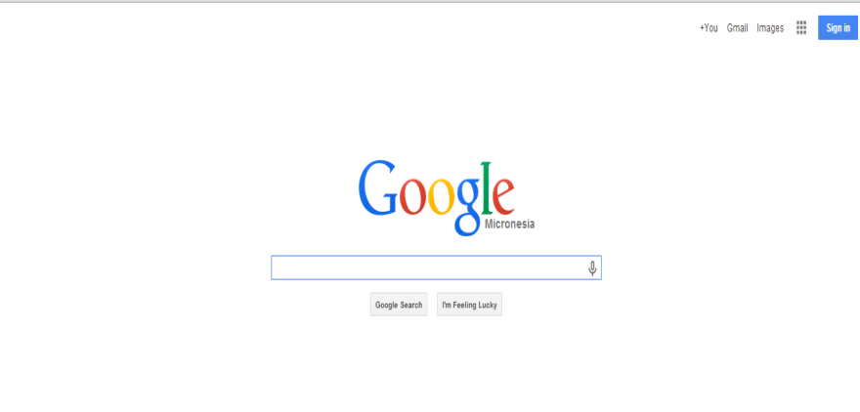
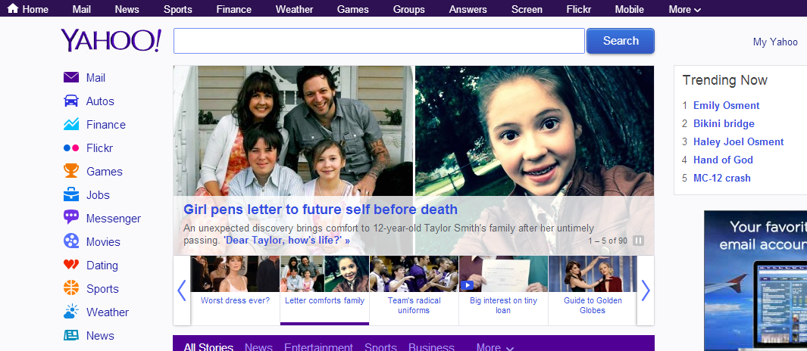
Networks and the Internet – Search Engine
22
22

Slide 23
Networks and the Internet – Search Engine
How to search?
Search should be specific
For example if you search for Science Project it will yield multiple results that is for elementary, high school, science or even for those with doctorate degree. But let’s say if you narrow it down for Grade 8, then you could probably type Science Project for Grade 8. Or again if it is for Chemistry it would be Chemistry science project for Grade 8.
+ Symbol – Use + symbol in addition to or specific to the one that you search for. For example if you want to search for science project for Grade 8 that could either be for chemistry and physics. Then you could search Science Project for Grade 8 +Chemistry +Physics
- Symbol – Use – symbol to negate a certain from your search for example. If you want to search for all type of science project for Grade 8 but it should be in chemistry. Then you could type Science Project for Grade 8 -Chemistry
23
23

Slide 24
What is an e-mail?
Shortcut for the word electronic mail.
Allows you to send and receive messages over the Internet
24
24

Slide 25
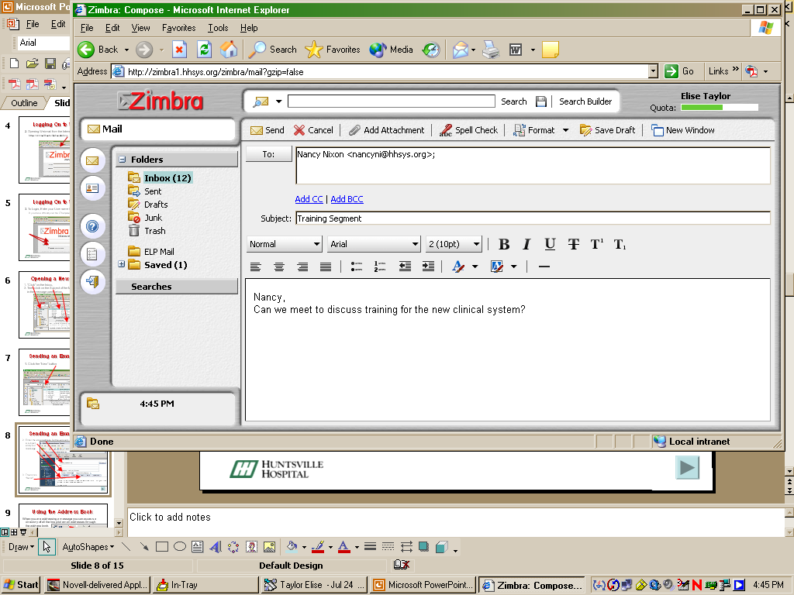
Parts of an e-mail
Carbon Copy – Other recipients that
should know your email.
Recipient of the email address, a subject and your message.
Blind Carbon Copy – Cannot be
seen by others that you send a copy
for a particular e-mail address.
25
25

Slide 26
E-mail Etiquette
Do not CAPITALIZE letters it is like shouting to a person that you are talking to.
Do not leave out the Subject blank it could create a bad impression on the recipient
Be polite and address properly the recipient (e.g. Dear Mr Smith or Hello Mr Smith)
Do not use e-mail to spam others. Spam is sending mass/bulk unsolicited e-mails
Do not forward chain letters or e-mail that is obscene, racist etc.
Do not open attached file unless you are sure that it is for you.
26
26

Slide 27
Activity 1
Make an e-mail to me stating your first impression of this class in paragraph form.
Send an email to me at emcastro@comfsm.fm
CC one of your classmate
27
27

